Slide 1
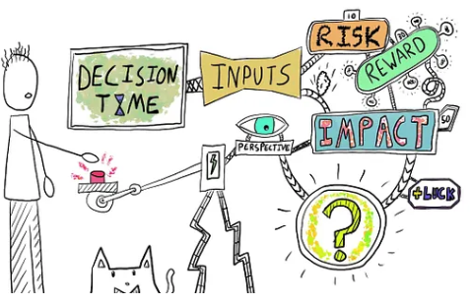
Intertemporal Analysis using Symbolic Regression
Image credits: https://uxdesign.cc/decision-making-for-product-managers-7fef3292cb65
Manila Devaraja

Slide 2


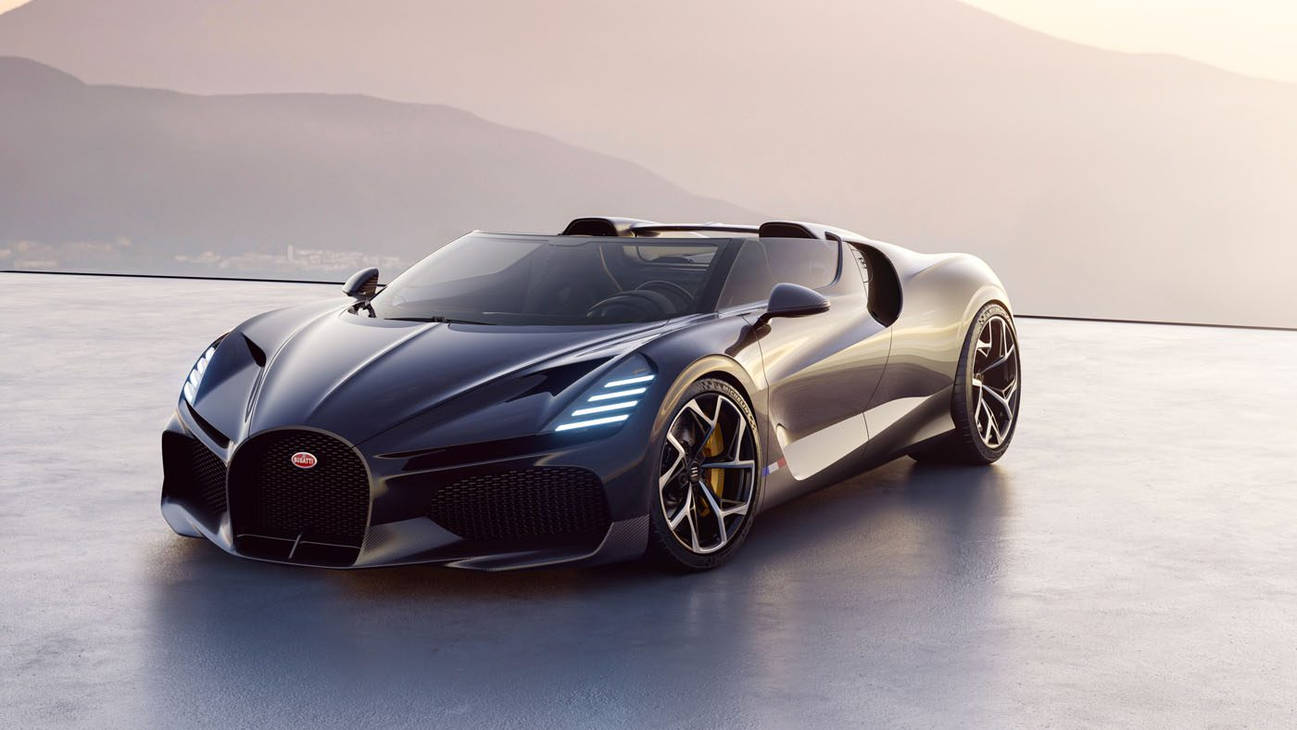
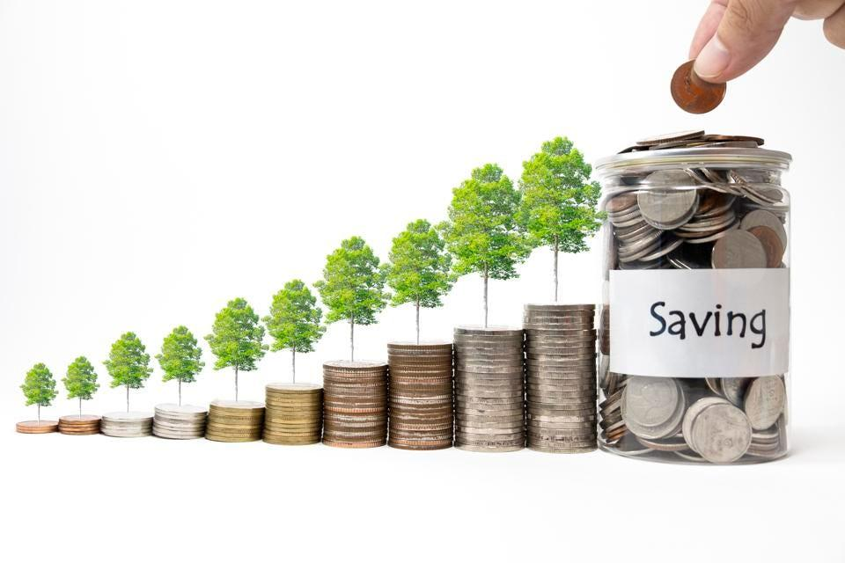


Human Decision-making
“LIFE IS TOO SHORT”

Slide 3
Intertemporal Analysis
Humans want instant gratification
Factors that contribute to the inter-
temporal decisions→ rich/poor, age,
gender
Some choice are well thought and
others, not so much
Image credits: https://uxdesign.cc/decision-making-for-product-managers-7fef3292cb65

Slide 4
Intertemporal Analysis
Quantifying decision making skill is challenging. But are some common factors that we could generalize for discounting behavior?
Mathematical models can give a logical and interpretable relationship between input and output.
Problem Statement:
“What influences how humans make decision that have impact over time?”

Slide 5
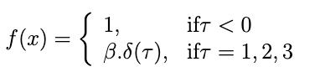
Mathematical models for discounting
The discount factor is:
But is it just dependent on time?
Are there other factors that contribute to the discounting function?

Slide 6
Questionnaire Curation
Individual features that we want to capture:
Latertime
CurrentValue
FutureValue
Loss/Gain
Elicitation
Timegap: Future time - Base time

Slide 7
Survey
Survey was formulated on Qualtrics platform[1]
Data range for each questions varied.
For eg: Current penalty
(1,2,3,4,5,6,7,8,9,10,15,20,25,30,35,40,45,50,55,60,65,70,75,80,85,90,100,120,140,150,160,180,200,225,250,275,300,350,400,450,500,550,600,650,700,750,800,850,900,1000,2000,2500,5000,7500,10000)
Demographic questions- age and gender was collected.
[1] https://www.qualtrics.com

Slide 8
Survey
Q1(Future Amount): Current reward, _________________,Gain Time
Q2(Gain time): Current reward, Future reward, _________________
Q3(Current Amount): _________________,Future reward, Gain Time
Q4(Future amount): Current penalty,_________________, Loss time
Q5(Loss time): Current penalty,Future penalty, _________________
Q6(Current amount):_________________,Future penalty, Loss time
Q7(Future amount): Current reward, Current time,Future reward,_______________

Slide 9
Data
Survey was conducted as a part of OOCP 2023(Business school pool) which is a part of the coursework.
A total of 79 participants took part
Each of them answered 7 questions. A total of 553 data points are collected.

Slide 10
DATA ANALYSIS - Change Format
Time = ___Years , ___ Months,___Days
Days =timeinyear∗365 +timeinyear/4
Days=timeinmonth∗30

Slide 11
DATA ANALYSIS- Wide to Long format
Time | FV | CV
T1_1 | F1_1 | C1_1
T2_2 | F1_2 | C1_2
… | … | ….
T2_1 | F2_1 | C2_1
T2_2 | F2_2 | C2_2
… | … | …
T3_1 | F3_1 | C3_1
T1 | F1 | C1 | T2 | F2 | C2 | …..

Slide 12
DATA ANALYSIS- New features
Time | FutureValue | CurrentValue | Loss/Gain | Elicitation | Timegap=time-basetime
 |  |  | Q1 | Futurevalue | basetime=0
 |  |  | Q2 | Time | basetime=0
 |  |  | Q3 | CurrentValue | basetime=0
 |  |  | Q7 | Time | basetime= now_time
 |  |  | Q4 | Futurevalue | basetime=0
 |  |  | Q5 | Time | basetime=0
 |  |  | Q6 | CurrentValue | basetime=0

Slide 13
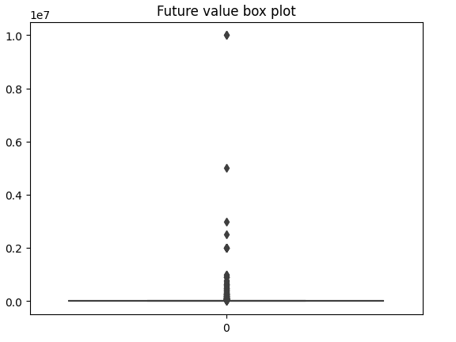
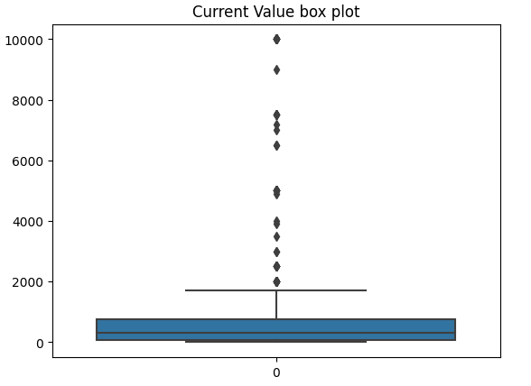
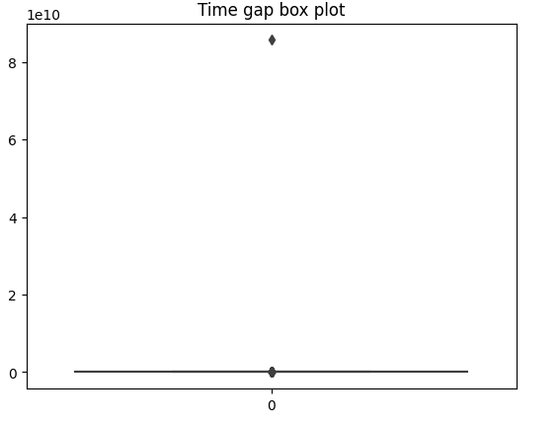
Data Analysis - Statistics
Box plot of each predictor data distribution

Slide 14
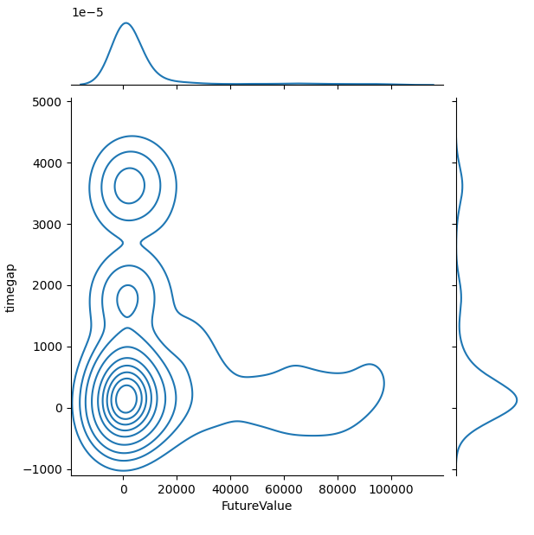
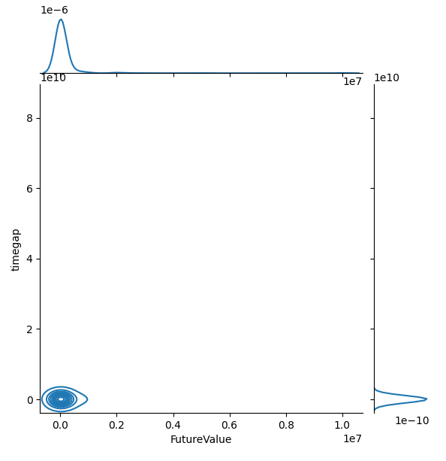
Data Analysis - Outlier Removal

Slide 15
Modelling
For the purpose of modelling we create three sections of data:
Time T1 | Future Amount F1 | Current Amount C1 | Future Amount | Gain
Time T2 | Future Amount F2 | Current Amount C2 | Time | Gain
Time T3 | Future Amount F3 | Current Amount C3 | Current Amount | Gain
Time T7 | Future Amount F7 | Current Amount C7 | Time | Gain
Time T4 | Future Amount F4 | Current Amount C4 | Futureamount | Loss
Time T5 | Future Amount F5 | Current Amount C5 | Time | Loss
Time T6 | Future Amount F6 | Current Amount C6 | Current Amount | Loss

Slide 16
Modelling- Linear Symbolic Model
Linear regression used to fit the three set of data.
Learns the weight coefficients of the linear features which is given as input.
Those weight coefficients can then be written in the symbolic form

Slide 17
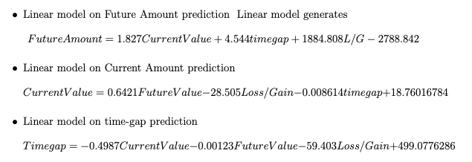
Linear Symbolic Models

Slide 18
Modelling- Polynomial Symbolic Model
Polynomial features computed are - (a,b,c,a^2,b^2,c^2,ab,bc,ca)
Along with the linear features, the polynomial features was also fed to the linear regression model.

Slide 19
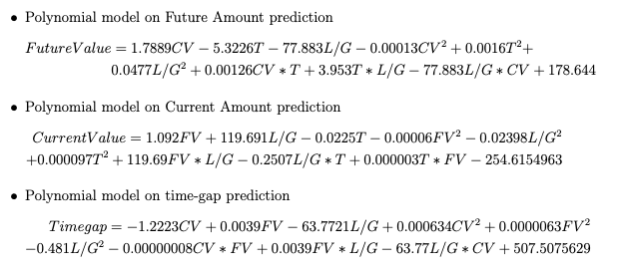
Polynomial Symbolic Models

Slide 20
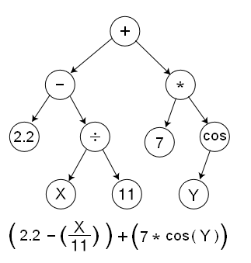
Genetic Programming
Search over the space the symbols and variables
to find the right symbolic function
As the generation evolve, GP perform three
operations- crossover, mutation,
selection

Slide 21
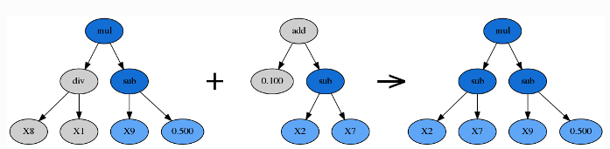
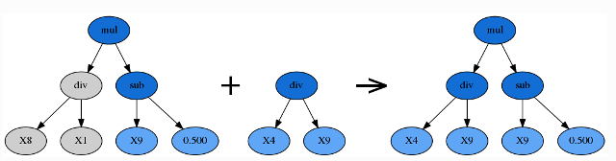
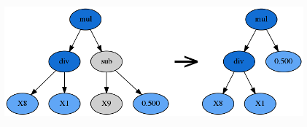
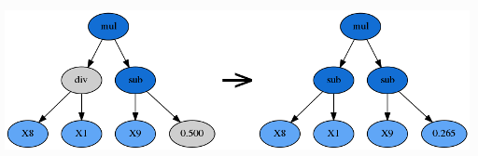
Genetic Programming
Cross over
Subtree mutation
Hoist mutation
Point mutation

Slide 22
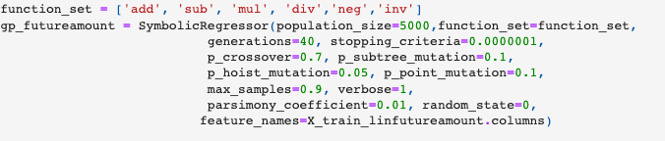
Genetic Programming - gplearn package

Slide 23
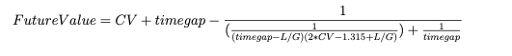
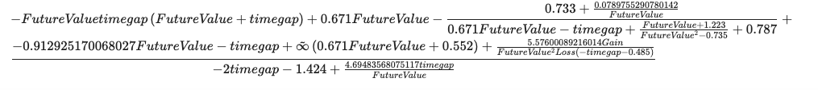
Modelling
CurrentValue=
Timegap=

Slide 24
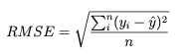
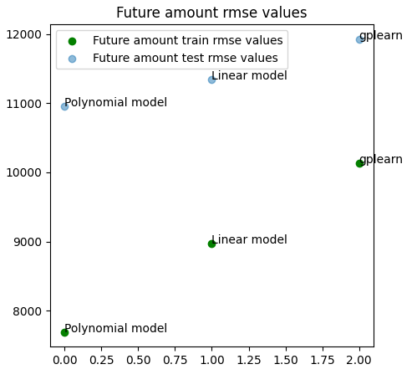
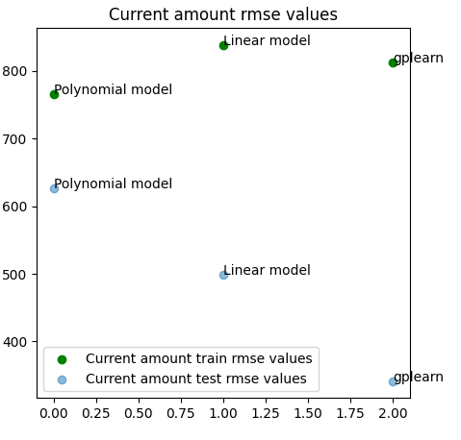
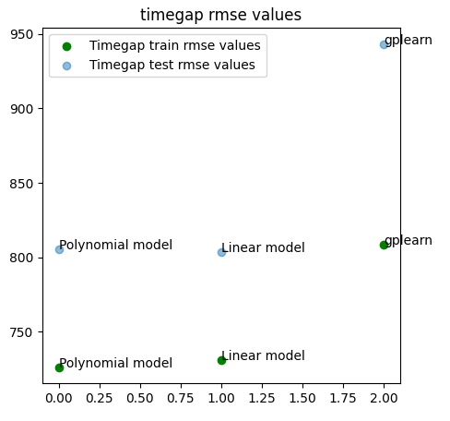
Modelling Analysis

Slide 25
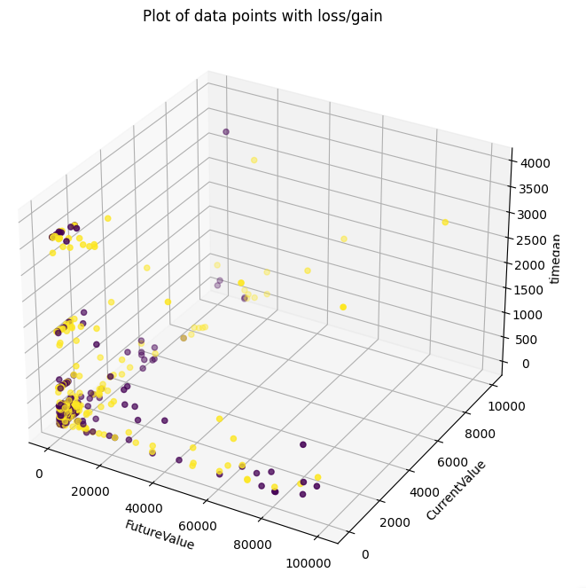
Experiment 2- Performance on full data

Slide 26
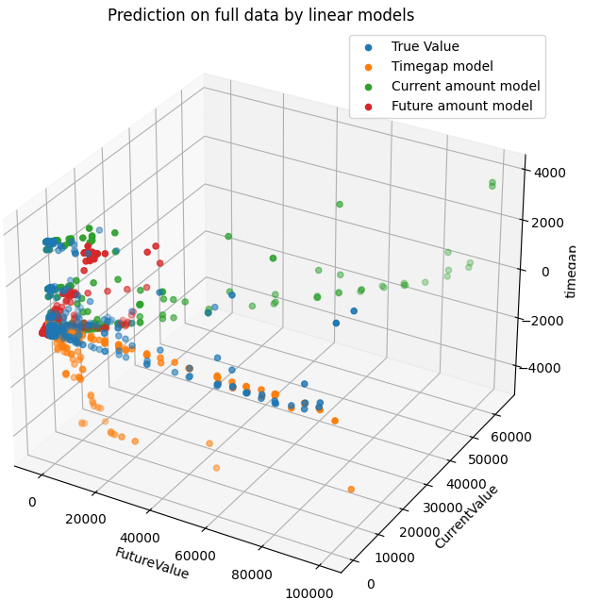
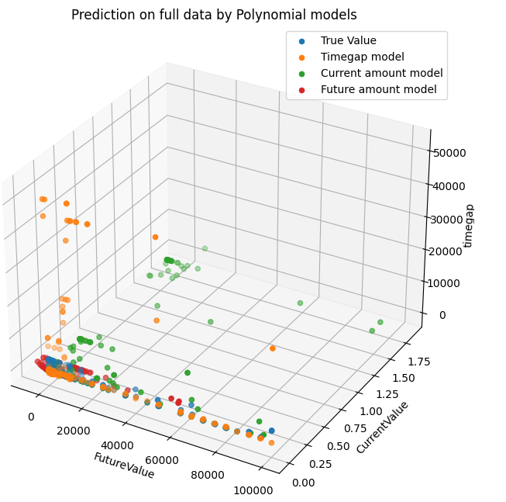
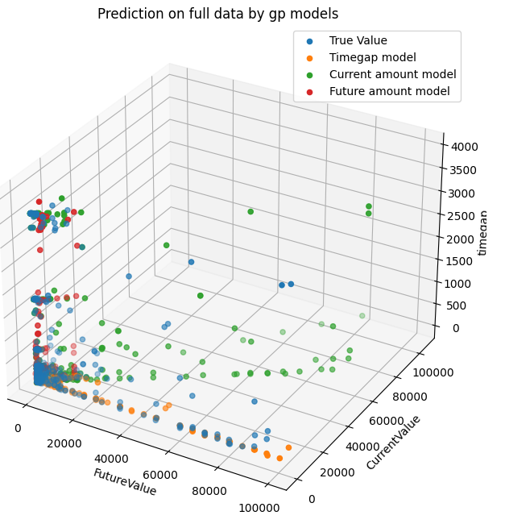
Performance on full data

Slide 27
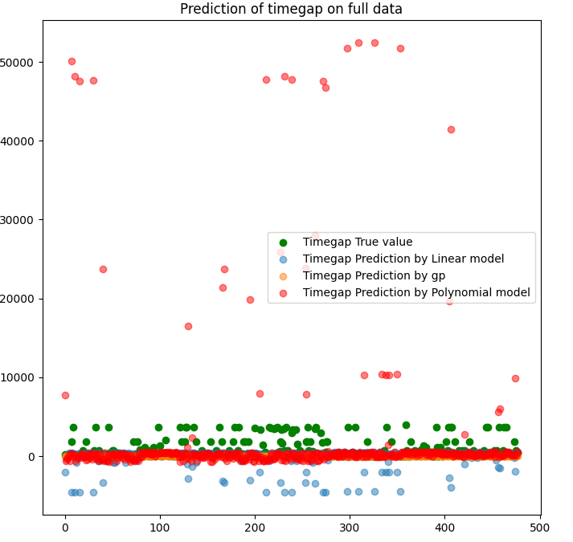
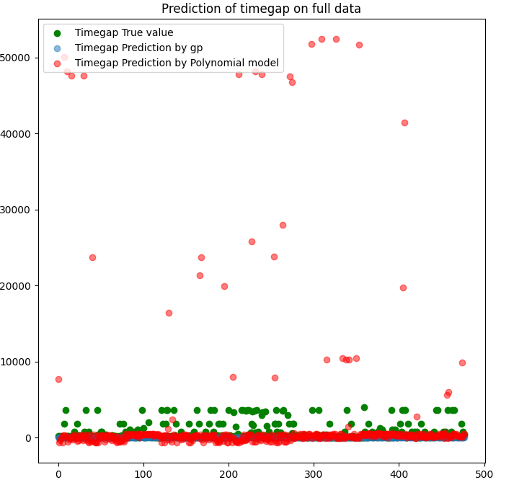
Experiment 2- Timegap prediction on full data

Slide 28
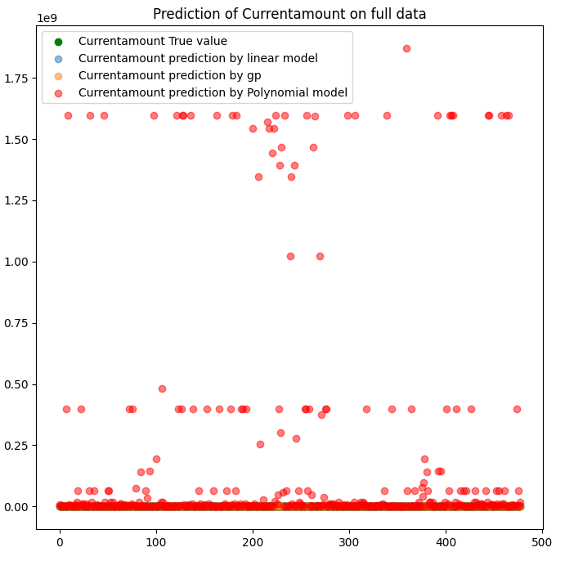
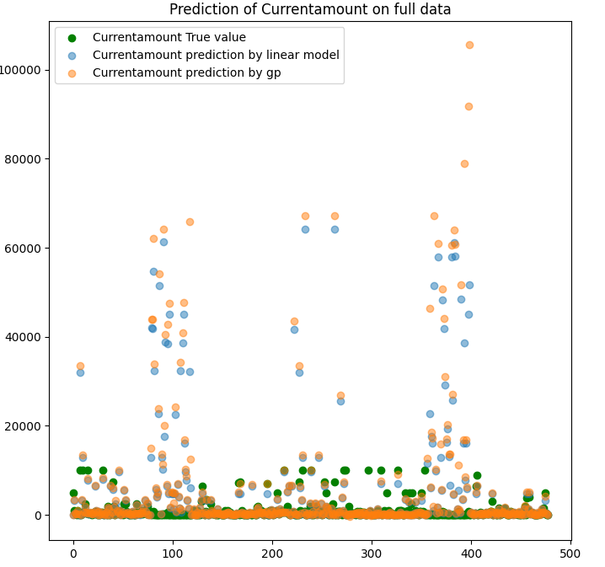
Experiment 2- Current amount prediction

Slide 29
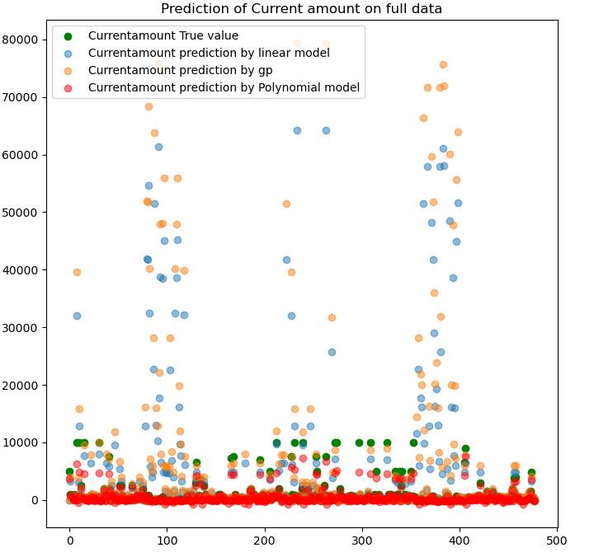
Experiment 3 - No Loss/Gain Function
We remove Loss/Gain function and repeat Experiment 1 and Experiment 2.
The expressions generated are much less complex with linear and polynomial models, but not so with gplearn
We do see that current amount prediction gets better with polynomial prediction.
However, theoretically, this experiment is not valid.

Slide 30
Conclusion
Conclusions are challenging with the data in hand and even if attempted, the conclusions might not be accurate.
This is just the first step to using better regression models to understand human discounting behavior

Slide 31
Future Directions
Key point- More data
Time gap was considered as a feature. Could use ‘Latertime’ and ‘timegap’ as relative features and can make conclusions better.
Use age and gender to analyze individual category behavior.
Capturing human behavior mathematically has long been a challenge. This is just a first step and it continues to be an open problem.

Slide 32
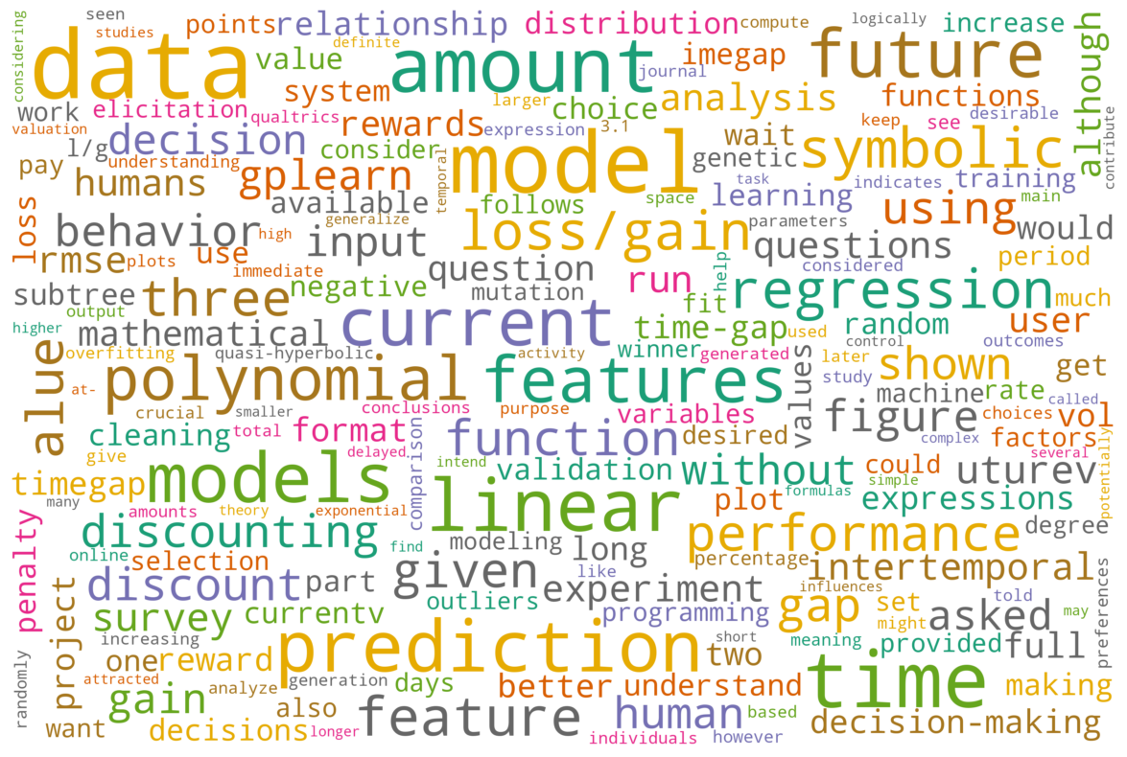
Thank you!

